Slide 1


K.RAMAKRISHNAN COLLEGE OF ENGINEERING
(AUTONOMOUS)
SPORTS SYSTEMS FOR TEAMS AND ATHLETES
Presented by,
Name : SAKTHEESHWARI SAADHANA . R
Register No. : 8115U23AD049
Roll No. : AD2349
Year : II AI&DS
Date of Review : _05/06/2025_________

Slide 2
PRESENTATION OVERVIEW
Abstract
Introduction
Architecture diagram
Module description
Implementation
Conclusion

Slide 3
ABSTRACT
The sports system is designed to provide a centralized platform for managing teams, athletes, and schedules efficiently, reducing manual work and improving coordination among coaches, players, and staff. Additionally, it offers real-time performance tracking and data analytics, allowing coaches to make informed, data-driven decisions to enhance athlete development and team performance.

Slide 4
INTRODUCTION
The system will handle match schedules, training sessions, and send timely alerts to all users.
Built-in messaging will allow coaches, athletes, and staff to communicate safely and efficiently within the platform.

Slide 5
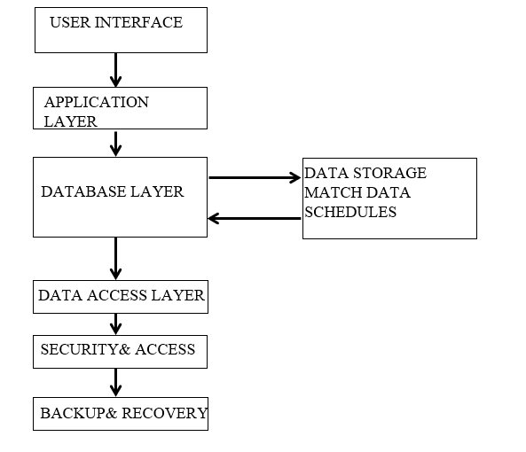
ARCHITECTURE DAIGRAM

Slide 6
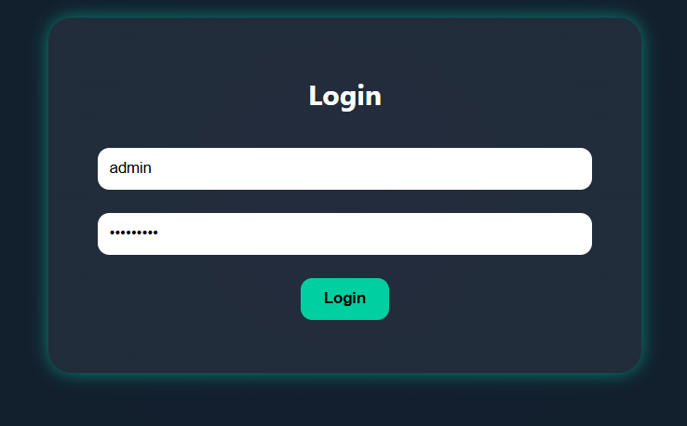
.
.
.
MODULE DESCRIPTION
1. User Management Module
Handles registration, login, profile creation, and role assignment (e.g., athlete, coach, admin).
Ensures secure access and personalized user experience based on roles.
.

Slide 7
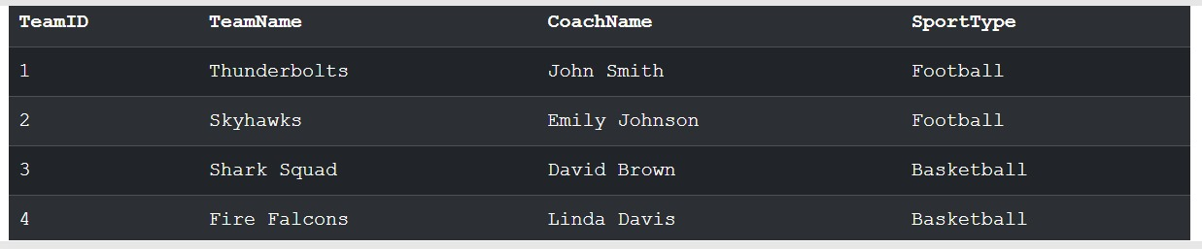
.
.
.
MODULE DESCRIPTION
2. Team Management Module
Allows creation and editing of teams, assigning players to teams, and tracking team history.
Coaches can manage rosters, team roles, and line-ups.
.

Slide 8
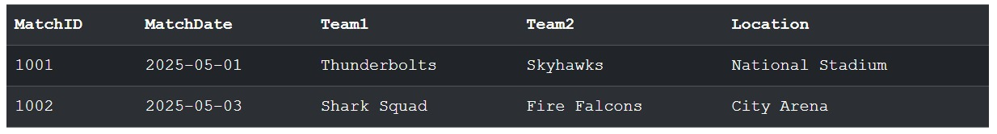
.
.
.
MODULE DESCRIPTION
3. Scheduling Module
Manages training sessions, matches, and tournaments.
Sends notifications and calendar updates to users.
Supports conflict detection and rescheduling.
.

Slide 9
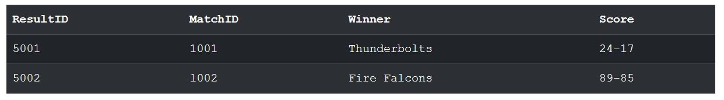
MODULE DESCRIPTION
4. Performance Tracking Module
Records and analyzes athlete statistics like speed, goals, assistant fitness levels, and other KPIs.
Coaches can view historical performance and track progress.
.

Slide 10
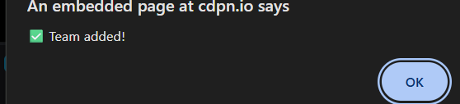
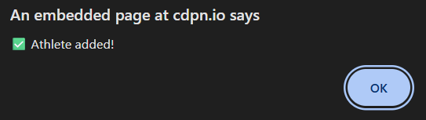
MODULE DESCRIPTION
5. Notification Module
Sends real-time alerts for schedule changes, messages, or important updates via email, SMS, or in-app notifications.
.

Slide 11
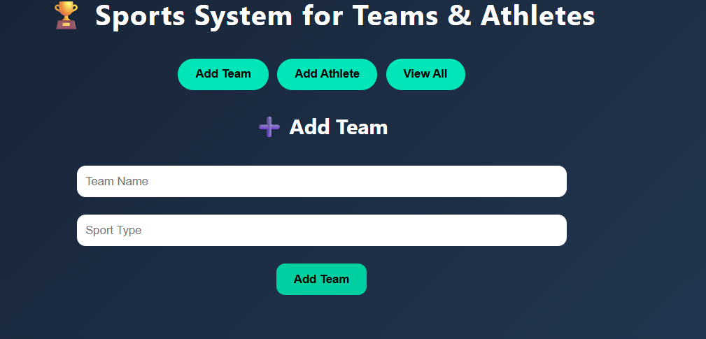
IMPLEMENTATION SCREENSHOT

Slide 12
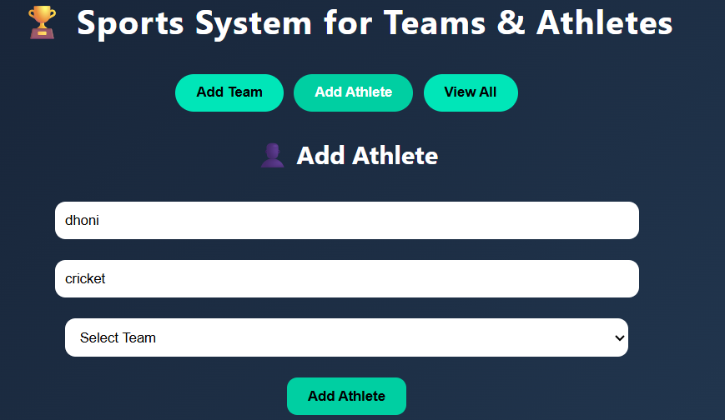
IMPLEMENTATION SCREENSHOT

Slide 13
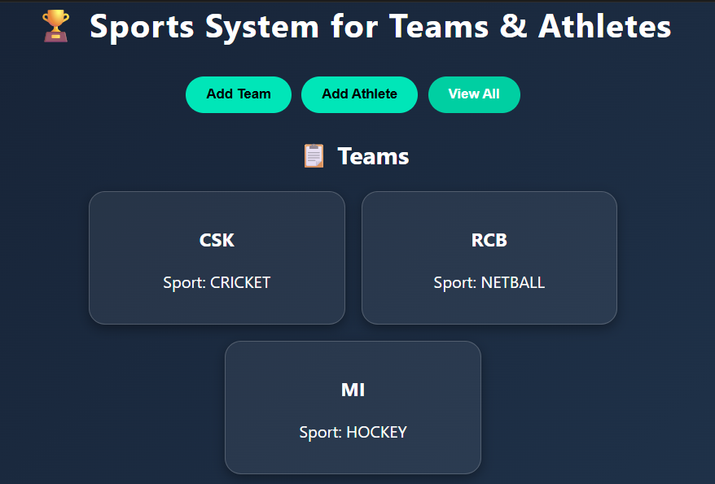
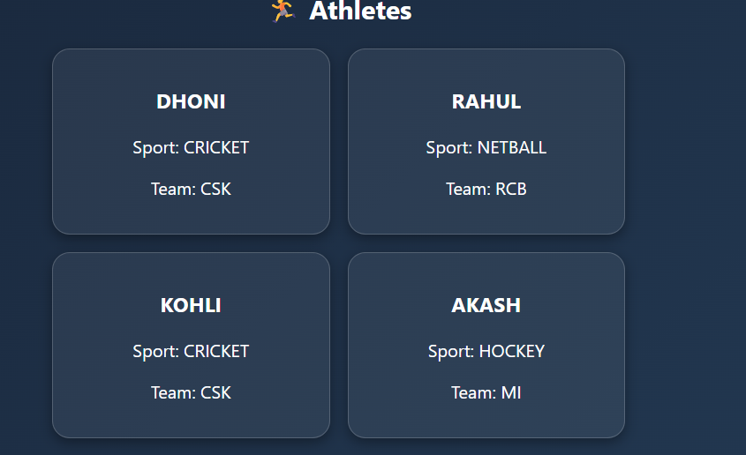
IMPLEMENTATION SCREENSHOT

Slide 14
CONCLUSION
The "Sports System for Teams and Athletes" database provides a comprehensive and efficient structure to manage all critical aspects of sports management, including teams, athletes, coaches, matches, injuries, and performance statistics. Overall, this project demonstrates the practical application of relational database design to solve real-world problems in sports management, offering a solid foundation for building more advanced sports analytics and management platforms in the future.

Slide 15


